Slide 1
Solutions Summit Series
National Federal Contractors Association
1425 K Street NW, Suite 350
Washington, D.C. 20005
www.nafcausa.com

Slide 2
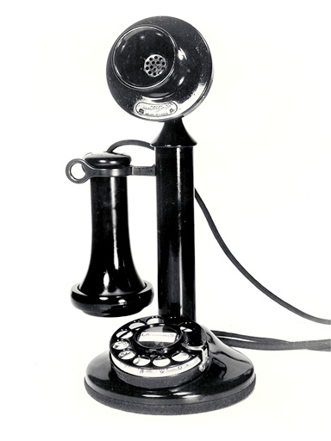
WAKE UP…It’s 2011
We’re thinking this…
Instead of thinking this

Slide 3
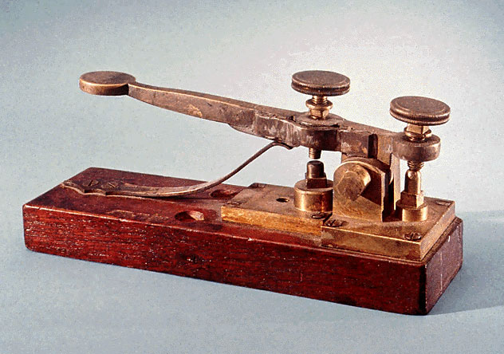
WAKE UP…It’s 2011
We’re thinking this…
Instead of thinking this

Slide 4
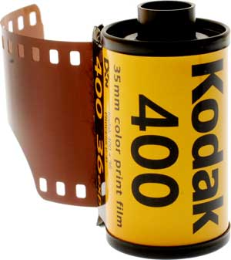
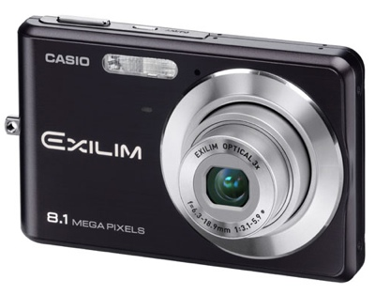
WAKE UP…It’s 2011
We’re thinking this.
Instead of thinking this

Slide 5
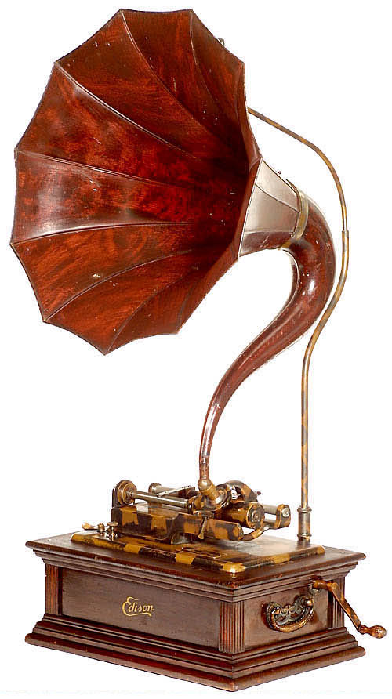
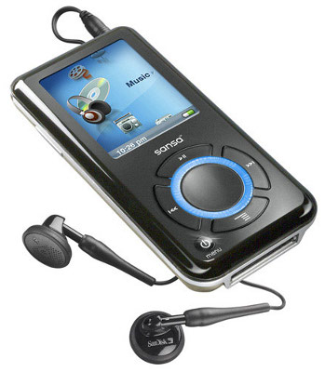
WAKE UP…It’s 2011
We’re thinking this.
Instead of thinking this

Slide 7
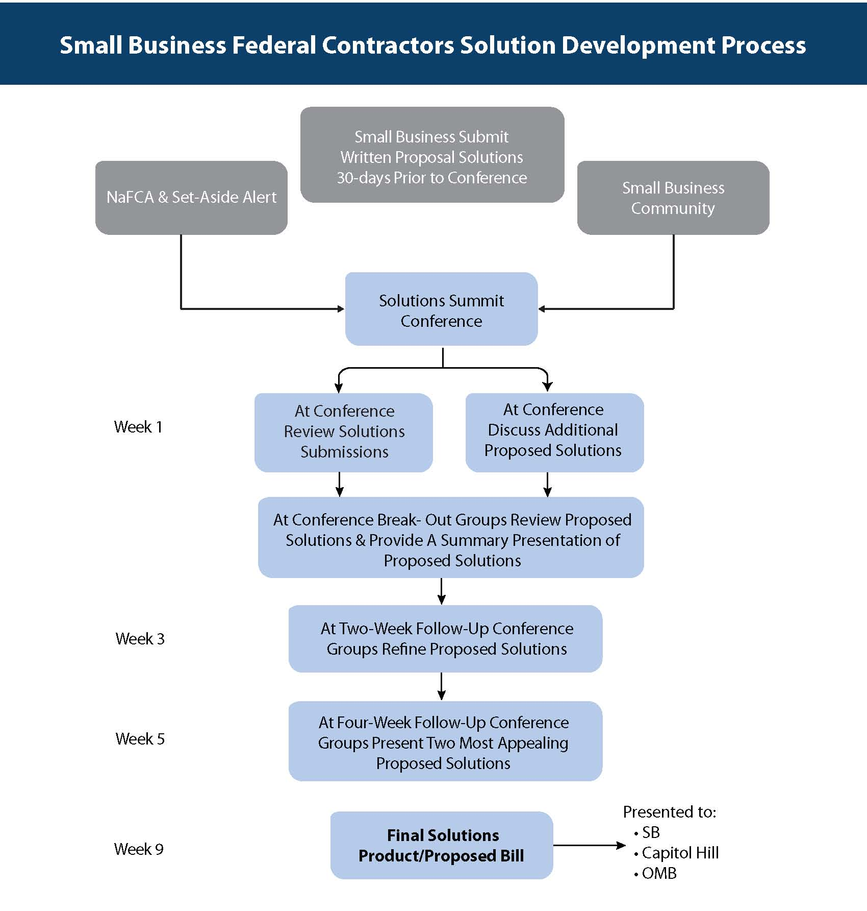

Slide 8
How can a $30M business compete with a $30 billion giant?

Slide 9
We as a community in 2011 have to develop solutions that are relevant in 2011 and will be relevant in 2020
Our Imperative…

